Slide 1
Green Marketing
Presented By:
Arpan Bhavsar
160410116019

Slide 2
Green Marketing
In simple terms it refers to the process of selling products and/or services based on their Environmental Benefits.

Slide 3
The AMERICAN MARKETING ASSOCIATION (AMA) DEFINITION
Retailing Definition:- The marketing of Products that are presumed to be Environmentally Safe.Social Marketing Definition:- The development and Marketing of Products designed to minimize negative Effects on the Physical Environment or to improve its Quality.Environment Definition:- The efforts by organizations to produce, promote, package anf reclaim products in a manner that is sensitive or responsive to ecologicak concerns.

Slide 4
Requirements
Production process compatible with the Environment Compatible with company's goals Satisfy the Customer's need

Slide 5
History
Late 1980s: Green Marketing beginning.
1987: Sustainable development concept.
1992 & 1992: Green Marketing Reference Books by Ken Peattie then Jacquelyn Ottman

Slide 6
Importance
The growing awareness all over the world regarding protection of the environment. Consumers are becoming more concerned about environmental friendly product.
Manufactures have recently recognized environmental concerns as a source of competitive advantage and have developed products with a green image.
Various regulations recently famed by the government to protect consumers and the society at large, led to the adoption of Green Marketing as a compulsion rather than a choice.

Slide 7
The Green Marketing Mix
A model Green Marketing Mix contains four "P's" :
Product
Price
Place
Promotion
Additional Social Marketing "P's" that are used in this process are:
Public
Partnership
Policy

Slide 8
Green Marketing "P's"
Product: A producer should offer ecological products which not only contaminate the Environment but should protect it and even liquidate existing environmental damages.
Price: Prices for such products may be a little higher than conventional alternatives.
Place: A distribution logistics is of crucial importance; main focus on ecological packaging.
Promotion: A communication with the market should put stress on environmental aspects.

Slide 9
Additional Social Marketing "P's"
Public: Effective Social Marketing knows its audience, and can appeal to multiple groups of people.
Partnership: Associating with other groups and initiatives to team up strengthens the chance of efficacy.
Policy: Policy change is needed, and media advocacy programs can be an effective complement to a social marketing program.

Slide 10
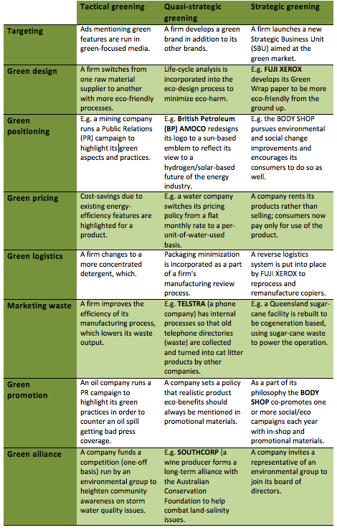

Slide 11
Green Washing
Disinformation disseminated by an organization so as to present an Environmentally Responsible Public Image.
The term Green Washing is derived from the term White Washing

Slide 12
Why Green Washing?
People are looking for environmental friendly products.
Corporations turn green washing to make themselves look more environmental friendly.

Slide 13
Examples
Cars
Paper Products
Personal Care and Beauty
Gas
Bottled Water etc.

Slide 14
Case Study
MacDonald
Coca cola
Phillips
Car sharing Service etc.

Slide 15
THANK YOU

